Slide 1
Our Cultural Learning Journey:
Intentional Communication to facilitate business success
Prepared and presented by
Nina E Woodard, SPHR/GPHR
EXCLUSIVELY for one of my Clients

Slide 2
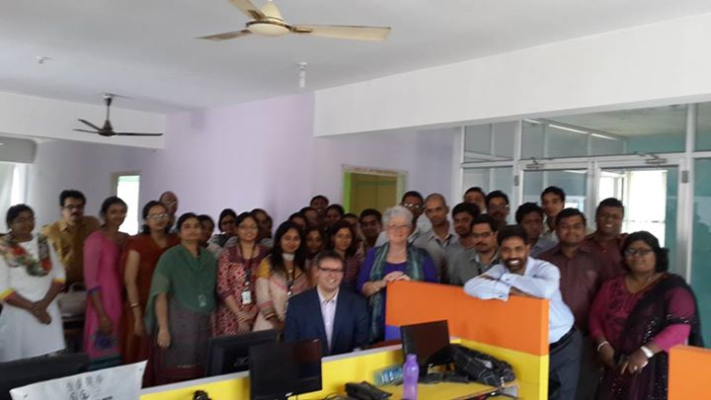

Slide 3

As we launch our day………..
Getting to know you
Select three items on your person that represent something about yourself.
Introduce yourself to the group using your three personal items and explaining the significance

Slide 4

What are your Expectations?
In the time I spend here today I want to…………..

Slide 5
IF I COULD…….
MAGICALLY CHANGE THREE ELEMENTS THAT IMPACT MY INTERACTIONS WITH THE INDIA TEAM AND MAKE THEM ALL WORK PERFECTLY, WHAT WOULD I CHANGE?

Slide 6

Who is it that I really VALUE on the India Team?
What do they do that supports my understanding of them as being valuable contributors?

Slide 7
What does it cost our bottom line if we just leave things the way they are?

Slide 8


Lunch Time

Slide 9
Simulation - Impacts of Cultural Differences (a group exercise)
Form groups of 4
Move to a location where your team can see each other and have space to place cards!
Review your rules and let the play begin!

Slide 10
Share your experience
How do you feel?
What Happened?
What did you Learn?
How Does this relate to the real world?
What if?
What Next?

Slide 11
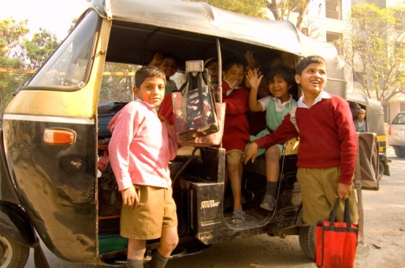
Demographics
Youthfulness
Education
English

Slide 12
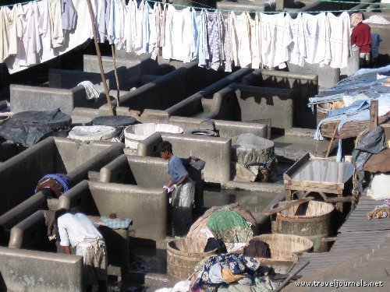
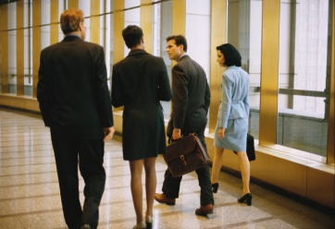
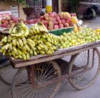

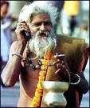
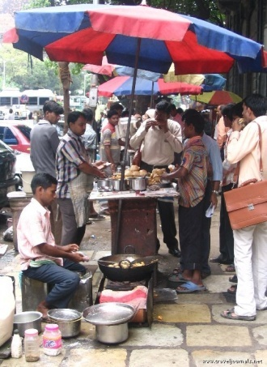

Changing at the speed of light……………..and not

Slide 13
Economics
3rd Largest in World (pp)
  Village farming
  Modern agriculture
  Handicrafts
  Modern industry
  Services (major growth area)
Exchange Rate 60.94 Rupee/Dollar September 10th

Slide 14
Economics
GDP (purchasing power parity):
$1.729 Trillion in 2010
had been estimated to be over $4 Trillion

Slide 15
Economics
Estimates of GDP 2nd Quarter 2014 – 5.7%
Inflation down today from a high of over 11 % to 7.5%
Industrial production 3.7%
*www.TradingEconomics.com

Slide 16
Challenges
Challenges of Global Communication Efforts
I’m speaking in English
I’m listening in Hindi
I’m thinking in Chinese/Thai

Slide 17

My personal Observations from living overseas and from my own age perspective!
Cultures look at age and “status” differently
Space and time are valued and looked at and experienced differently
Voice and discussions may be louder
Risk takes on different perspectives
Language differences
  English words may have different meanings in different cultures
    Boot
    Bonnet

Slide 18
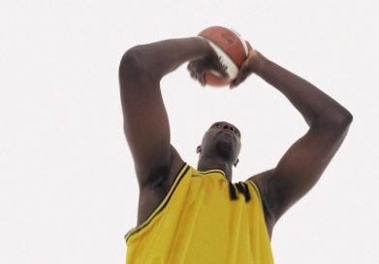
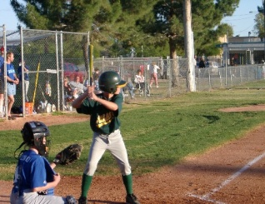
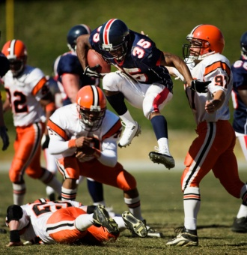
Many American expressions are based on our sports!
Jumping through hoops
Cover all the bases
Hit a home run
Tackle the job
End run

Slide 19

SPECIFIC LANGUAGE ISSUES
Pronunciation and Basic American English
Pronunciation (controversy)
Use of Prepositions
  Differences between American usage and other spoken English
    Influenced by local cultures
    Choice of the preposition
      On the team……..in the team
      On the weekend….at the weekend
    And whether to use at all
      Please write me…please write to me
  Phrasal Verbs
    Acting out/ make up / changing a tire
  Fixed Phrases
      Getting in my hair
      Letting the cat out of the bag
SPEAKING TO BE
UNDERSTOOD AND
LISTENING TO UNDERSTAND

Slide 20
SPECIFIC LANGUAGE ISSUES
More examples
American English - hood
British English - bonnet
American English - trunk
British English - boot
American English - truck
British English - lorry

Slide 21

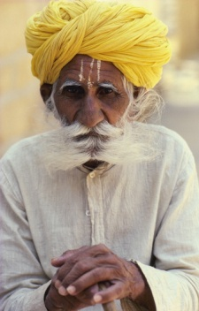
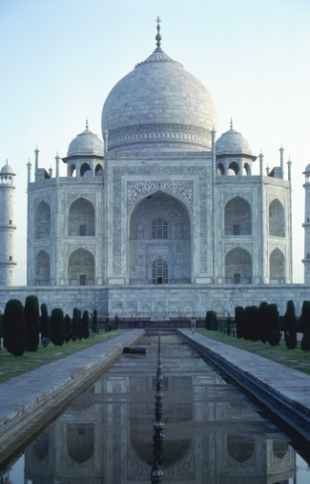
Examples of
Indian Idioms
House full
Homely
Hoardings
Abscond
Contest
I Fired him
DO YOU HAVE SOME
YOU CAN SHARE FROM
YOUR LIFE OR EXPERIENCE?

Slide 22
MORE EXAMPLES
Donkey’s Years
Your this thing
Do the needful
What’s your good name?
Prepone

Slide 23
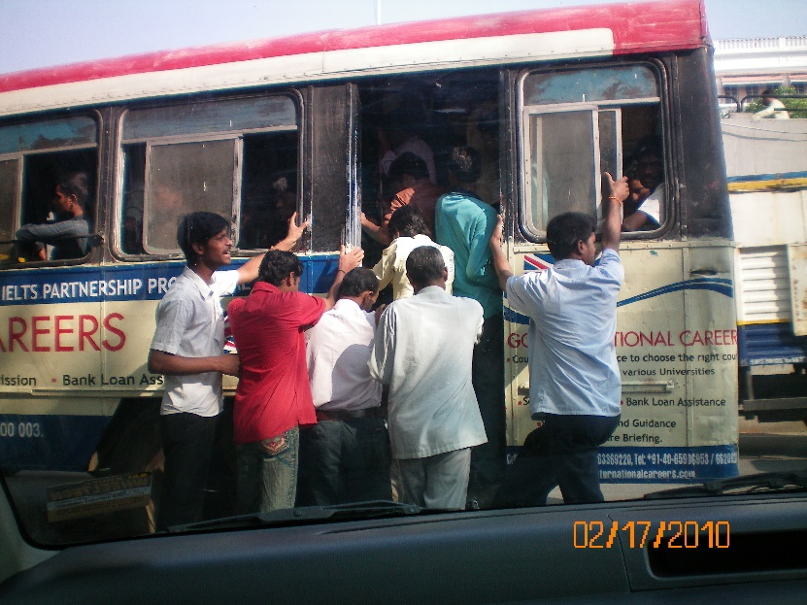
In The Indian Context
Sights and Sounds of Chennai
http://youtu.be/EnhJWuRKMYw
Mall shopping Chennai
http://youtu.be/B0w98P7RZUU
Seeing the City
http://youtu.be/0C2Yk3zaU_E

Slide 24
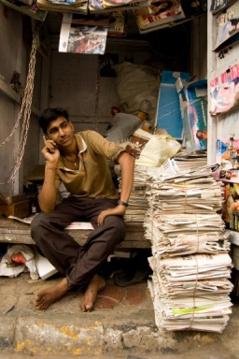
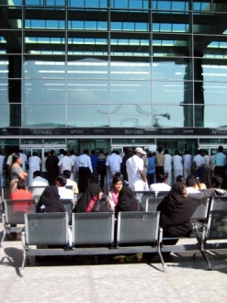
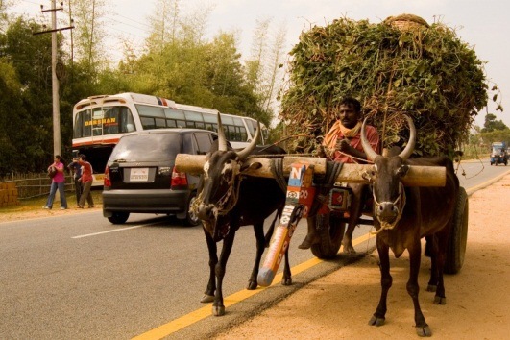
Communications/Transportation
Telephones – main lines in use 34.29 million (June 2011)
Mobile Cellular – 851.70 million (June 2011)
Internet users – 100 million (2010)
Airports and airstrips : 449
Railways: 952 Billion passengers 2010
  Freight and transportation strong

Slide 25
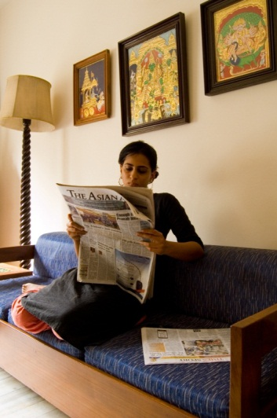
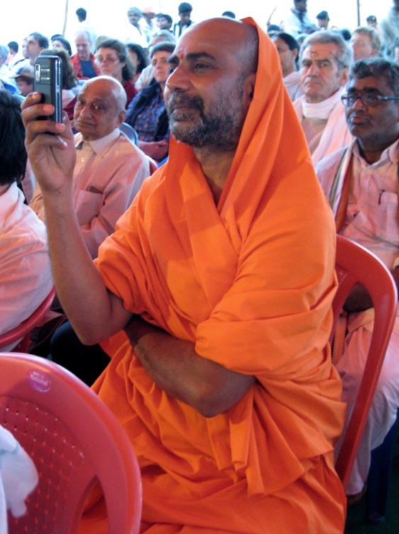
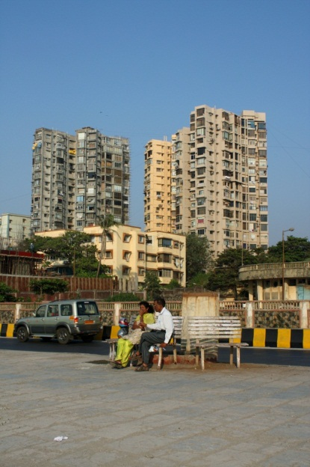
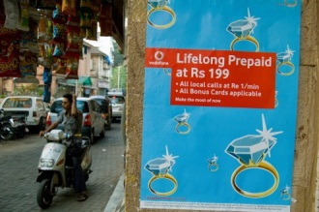
Environment

Slide 26
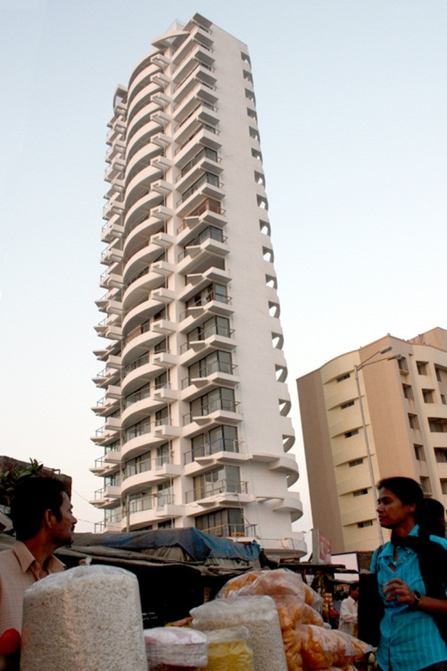
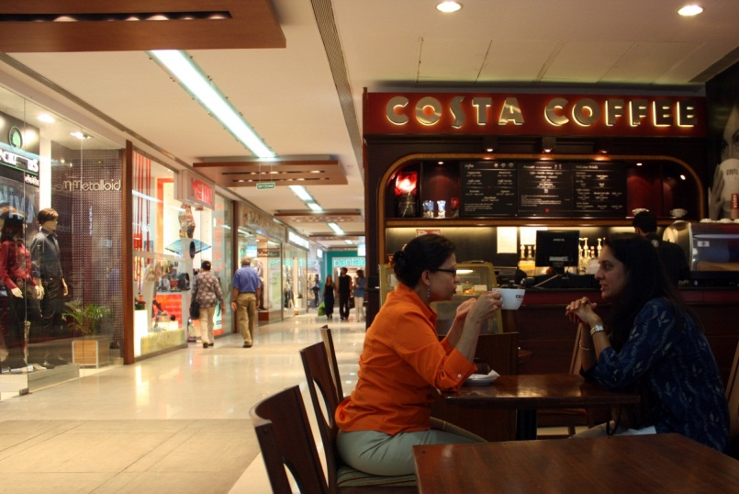
Environment

Slide 27
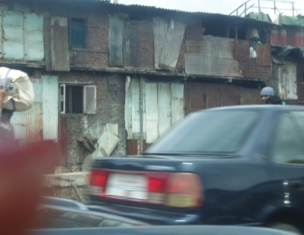
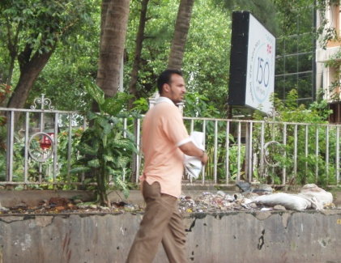
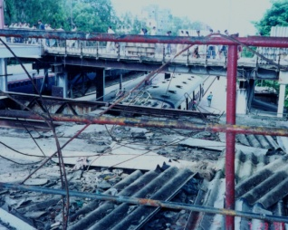
Ground realities………

Slide 28
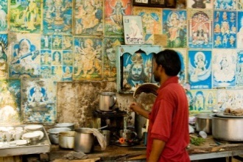
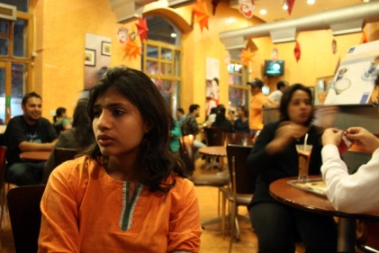
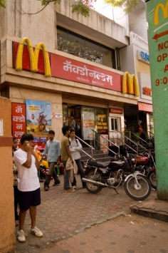
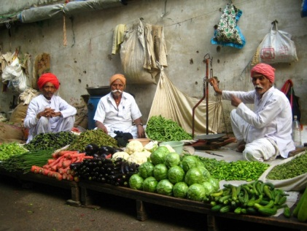
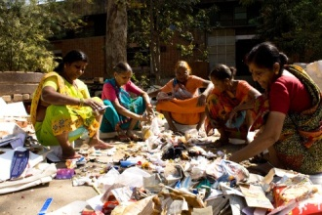
Business
Organized
Unorganized
Agriculture 18% of GDP
Industry 27% of GDP
Services and Transportation 55% of GDP

Slide 29
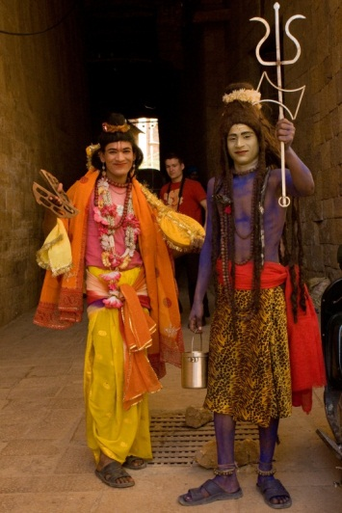
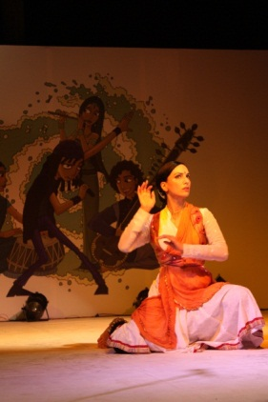
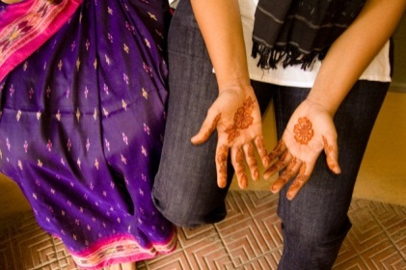
Culture
Steeped in history
Interwoven with religious influences
Diverse
The Indian Context
Deeply rooted in all Indians

Slide 30
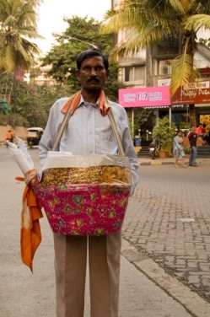
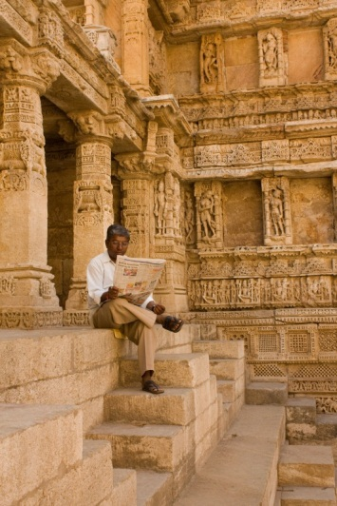
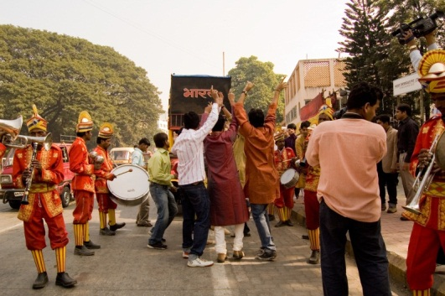
Culture
Guests are god
Work is Worship
Respect for elders
Respect for one another
Democracy
Past, present and future
Caste, Women, Religious beliefs

Slide 31
Politics
A federal republic – integrates United Kingdom and US constitutional systems
Three branches: Executive, Judiciary and Parliament
Many Parties – requires coalition to win
There is an active communist party
President Pranab Mukherjee
Prime Minister Modi – hopeful public

Slide 32
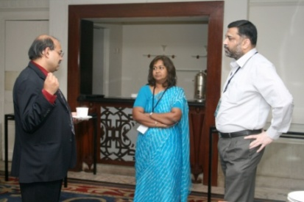
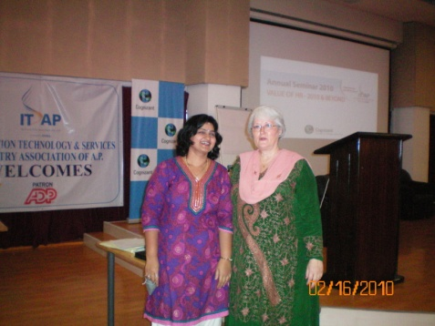
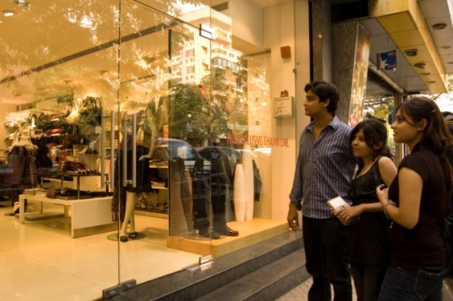
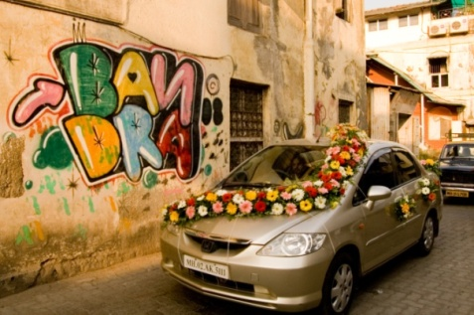
Influenced by the West?
TV Movies and Music..

Slide 33
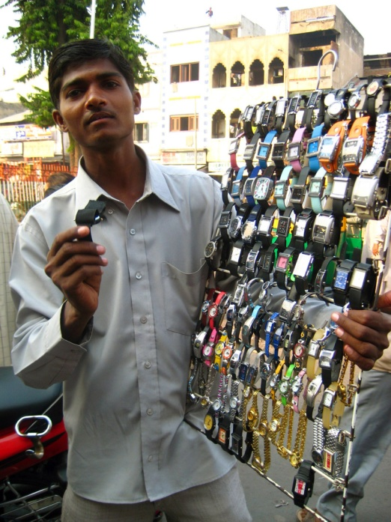
How much does it cost?
Cell phones: depending on model $10 and up
IPOD - $150 and up
DVD’s black - $2 regular $10
Prices vary – for the haves and have nots and for Indians and foreigners

Slide 34
What happens when you hear or experience something that doesn’t make sense in your frame of reference?

Slide 35
Basic UNDERSTANDING

Slide 36
WHAT WE SEE AND HEAR IS TRANSLATED BY OUR MIND IN OUR FRAME OF REFERENCE ….LISTENING AND READING all THE SIGNS (VERBAL AND NON-VERBAL HELP US

Slide 37



Success in any business dealing or culture is all about understanding and being understood

Slide 38

Appreciative Inquiry
One approach to improving performance
http://youtu.be/QzW22wwh1J4

Slide 39
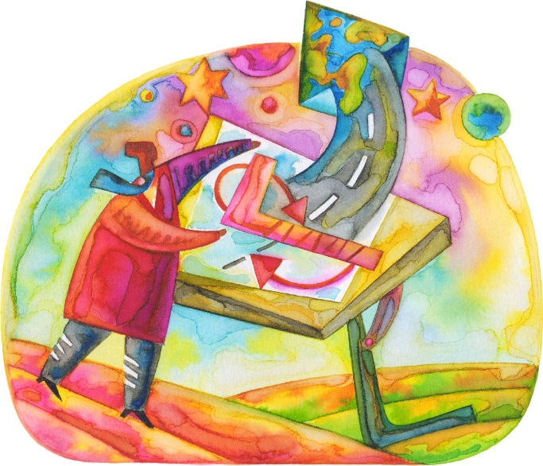
Active Learning Adventures
Role Play
Looking ahead – planning for the future
Teams of 3
Practice using a more Appreciative approach to solving the problem posed in your scenario
2 team members play the roles described the 3rd serves as an observer and uses the evaluation sheet to make notes.
What will I do differently when I got back to work next week?

Slide 40
Thank you for this opportunity to play a part in your learning journey!
You all are awesome!

